Slide 1
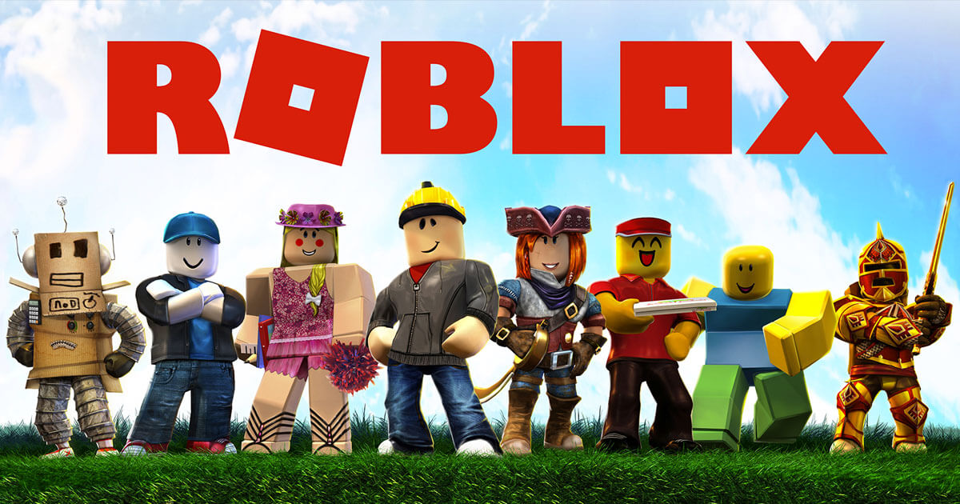
Loops & Functions

Slide 2
COURSE TIMELINE
Term Project
Term Project
Programming Projects with Lua
Roblox Studio Basics
Constraints Pt 1
Constraints Pt 2
Intro to Lua
Parameters
Loops & Conditionals
Loops & Functions
W1
W2
W3
W4
W5
W6
W7
W8

Slide 3

Edmodo
Resource Hub
Slides
Learning Material
Exercises/ Assignments / Quizzes
Tutorial Videos
WHEN TO CHECK
FRIDAY AFTERNOON EVERY WEEK
Communication
Directly message teachers
Post Questions
Post Screenshots of your work

Slide 4
TODAY’S LESSON
1
REVIEW: GAME
2
LOOPS
3
FUNCTIONS
4
CLASS PROJECT: RACING GAME

Slide 5

REVIEW
Notes:
https://codecombat.com/students?_cc=BackPlateTurnhttps://codecombat.com/students?_cc=BackPlateTurn

Slide 6
NEW CONCEPTS

Slide 7
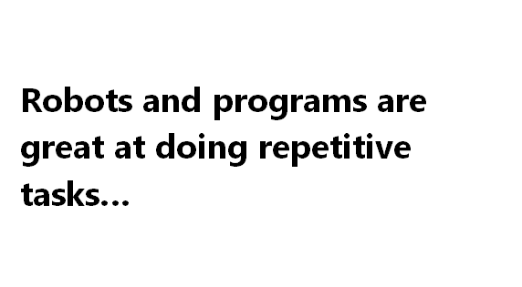

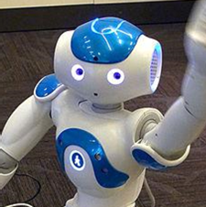
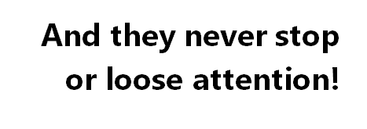

Slide 8
WHILE LOOPS
While Loops can repeat a task… literally forever!
At least…
until a condition is met that tells it to stop.
Typing 100 print statements is boring
solution: Use a while loop.

Slide 9
In other words...
A loop tells the computer how many times to run a piece of code.
What do you think this does?
>>> i = 0
>>> while i < 3:
... print("i is " + str(i))
... i = i + 1

Slide 10
Introducing … while loops!
What do you think this does?
>>> i = 0
>>> while i < 3:
... print("i is " + str(i))
... i = i + 1
i is 0
i is 1
i is 2
>>>

Slide 11
Introducing … while loops!
What do you think this does?
>>> i = 0
>>> while i < 3:
... print("i is " + str(i))
... i = i + 1
i is 0
>>>
i is 0

Slide 12
Introducing … while loops!
What do you think this does?
>>> i = 0
>>> while i < 3:
... print("i is " + str(i))
... i = i + 1
i is 0
i is 1
>>>
i is 1

Slide 13
Introducing … while loops!
What do you think this does?
>>> i = 0
>>> while i < 3:
... print("i is " + str(i))
... i = i + 1
i is 0
i is 1
i is 2
>>>
i is 2

Slide 14
Introducing … while loops!
What do you think this does?
>>> i = 0
>>> while i < 3:
... print("i is " + str(i))
... i = i + 1
i is 0
i is 1
i is 2
>>>
i is 3
We are only going to be in the loop while i is less than 3.
If i is 3, it is too big.
The code is skipped and we move on!

Slide 15
Incrementing… while loops!
How could we make the loop print this?
i is 0
i is 2
i is 4
i is 6

Slide 16
Incrementing… while loops!
>>> i = 0
>>> while i <= 6:
... print("i is " + str(i))
... i = i + 2
i is 0
>>>

Slide 17
Incrementing… while loops!
>>> i = 0
>>> while i <= 6:
... print("i is " + str(i))
... i = i + 2
i is 0
i is 2
>>>

Slide 18
Incrementing… while loops!
>>> i = 0
>>> while i <= 6:
... print("i is " + str(i))
... i = i + 2
i is 0
i is 2
i is 4
i is 6
>>>

Slide 19
WHILE LOOP STRUCTURE
Code
Condition
Yes
No
Do something
Code

Slide 20
CLASS ACTIVITY

Slide 21
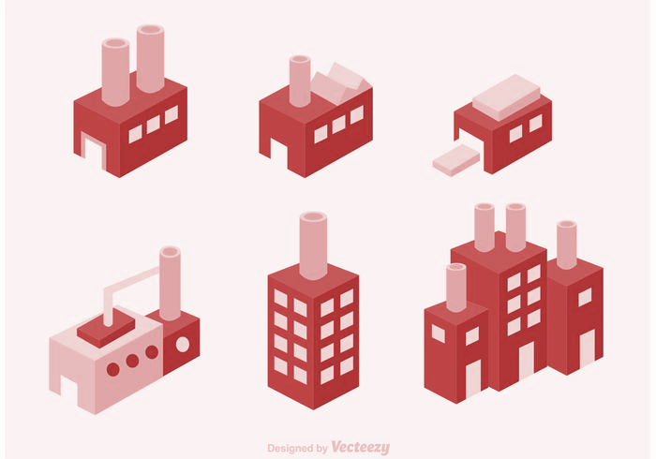
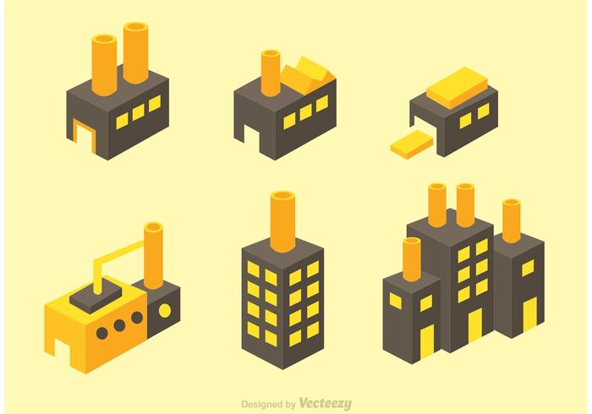
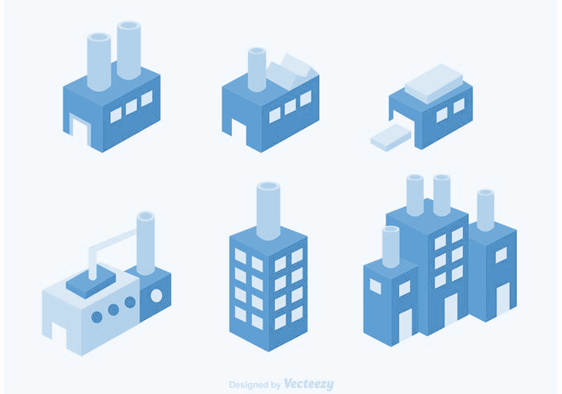
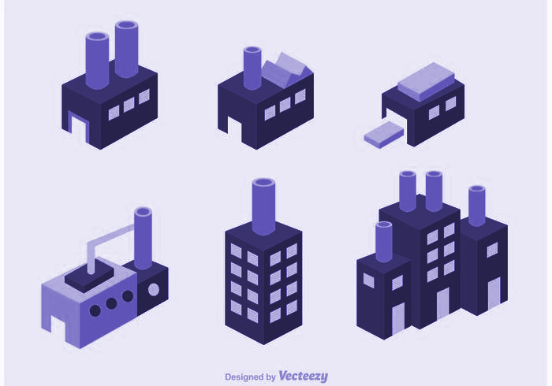
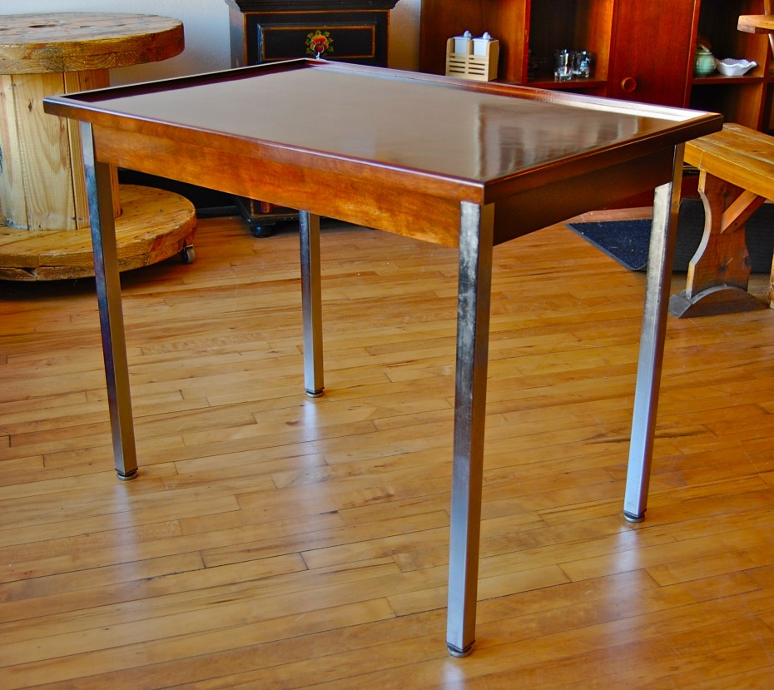
FUNCTIONS
Metal Worker
Functions are like factories!
Timber Mill
Your main factory!
Look at this beautiful table I made!
Outsourcing made it simple!
Cupcake factory
Running a factory doesn’t mean doing all the work yourself, you can get other factories to help you out!

Slide 22
Can I order 4 metal poles please! 80cm long.
FUNCTIONS
I’d like to place an order for a piece of wood. 2 meters by 1.5 meters.
Metal Worker
Your main factory!
Timber Mill
Order
Order
It will be delivered straight away!
Delivery
Sure thing! Coming right away!
Delivery
Cupcake factory

Slide 23
FUNCTIONS
You can write these once and then use them lots of times! They can be anything you like!
Your main code!
Uses stats to make decisions
Does calculations
You can write a bunch of helpful functions to simplify your main goal!

Slide 24
FUNCTIONS
Defining our own functions means:
We cut down on repeated code
Nice function names makes our code clear and easy to read
We can move bulky code out of the way

Slide 25
Introducing … while loops!
Then you can use your function by calling it!
#
#
#
^..^ #####
=TT= ;
#########
# # # #
M M M M
#
#
#
^..^ #####
=TT= ;
#########
# # # #
M M M M
def cat_print():
print("""
#
#
#
^..^ #####
=TT= ;
#########
# # # #
M M M M """)
cat_print()
cat_print()
When using a function in a script make sure you define the function first.
It doesn’t matter if you call it from inside another function though!

Slide 26
Functions can take multiple arguments
Often we want to work with multiple pieces of information.
You can actually have as many parameters as you like!
This function takes two numbers, adds them together and prints the result.
>>> def add(x, y):
... print(x + y)
>>> add(3, 4)
7

Slide 27
Creating Functions
function arguments
function name
def add(x, y): >>> add(2, 3)
the def keyword
definition
function name

Slide 28
Giving something back
At the moment our function just does a thing, but it‘s not able to give anything back to the main program.
sum has no value!
>>> def add(x, y): ... print(x + y) >>> sum = add(1, 3) 4 >>> sum

Slide 29
CLASS ACTIVITY

Slide 30
CLASS PROJECT

